Slide 1
Develop a system to spot malicious or unauthorised users on networks
Intrusion Detection Systems
As the use of computer networks and the number of applications operating on top of them both grow dramatically, network security is becoming more and more important.
However, all systems have security flaws, which could lead to an increase in attacks that
could have a detrimental impact on the economy.
Therefore, identifying weaknesses in the network's system has become more crucial, and it must be done as accurately as possible in real time.
In this notebook, a model will be developed and trained using an SVM classifier to
determine whether or not a network packet contains an attack.

Slide 2


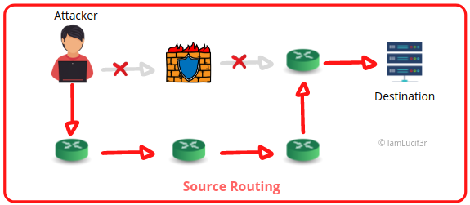
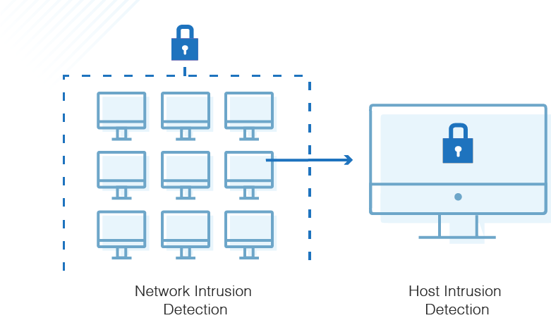
Problem
FALSE POSITIVE RATE
EVASION
SCALABILITY
This refers to the number of times that an intrusion detection system incorrectly identifies normal activity as an intrusion. This can lead to wasted resources and a lack of trust in the system.
This refers to the ability of an attacker to evade detection by the intrusion detection system. This can be achieved through techniques such as protocol manipulation, fragmentation, or obfuscation.
As the number of network devices and users increases, the ability of the intrusion detection system to handle the increased volume of data becomes increasingly important. This can be a significant challenge, particularly for systems that rely on traditional signature-based detection methods.

Slide 3


Solution
Machine learning solutions for intrusion detection are a type of artificial intelligence that uses algorithms to automatically identify patterns and anomalies in network traffic, system logs, and other data sources that can indicate the presence of a security threat. These solutions can be used to detect a wide range of security threats, including malware, intrusion attempts, and other malicious activity.
Anomaly Detection
Supervised Learning
Unsupervised Learning
This approach uses labeled data to train a machine learning model. The model is then used to classify new data, such as network traffic, into different categories such as normal or malicious.
This approach uses machine learning algorithms to identify patterns of activity that deviate from normal behavior. Anomaly detection systems can be trained on historical data to learn what normal activity looks like, and then use this knowledge to flag any activity that deviates from the norm.
This approach uses unlabeled data to train a machine learning model. The model is then used to identify patterns in the data that can be used to classify new data into different categories.

Slide 4
Data set Implemented Models
KDD
Logistic Regression
K-nearest neighbors
Naïve Bayes Classifier

Slide 5

Contact Me
Umar Adam I
Email
Location
Phone
startupcampus@gmail.com
Nile University of Nigeria Abuja
08149748622
0807 051 2994
0818 214 5657
Thank You

